Slide 1
Kyber, Saber, and NTRU oh my!

Slide 2
A few questions
Which of Kyber, Saber, and NTRU do we prefer?
If IP were not an issue, which one would we prefer?
Notes:
We have the option of standardizing more than one, of course, but we still need to determine our preference.

Slide 3
Evaluation Criteria
Security
Security categories offered
(confidence in) security proof
Known attack analysis
classical/quantum complexity
Performance
Size of parameters
efficiency of KeyGen, Enc, Dec, Sign, Verify in software/hardware
decryption failures or other implementation issues to be aware of
real-world experiments
Algorithm and implementation characteristics
Advantages and disadvantages
IP status
side-channel resistance (constant-time code?)
simplicity and clarity of documentation
flexibility

Slide 4
Security – categories offered
 | Kyber | Saber | NTRU
 |  |  | NTRUhps2048509
Category 1 | Kyber512 | Lightsaber | NTRUhrss701 NTRUhps204877
Category 3 | Kyber768 | Saber | NTRUhps4096821
Category 5 | Kyber1024 | Firesaber | NTRUhps40961229 NTRUhrss1373
The NTRU submission document says if you consider local models, then you’d basically move everything down one row

Slide 5
Security – coresvp estimates
 | Kyber | Saber | NTRU
 |  |  | NTRUhps2048509 C: 105 bits
Category 1 | Kyber512 C: 118 bit Q: 107 bits | Lightsaber C: 118 bits Q: 107 bits | NTRUhrss701 C: 134 bits NTRUhps204877 C: 144 bits
Category 3 | Kyber768 C: 183 bits Q: 166 bits | Saber C: 189 bits Q: 172 bits | NTRUhps4096821 C: 178 bits
Category 5 | Kyber1024 C: 256 bits Q: 232 bits | Firesaber C: 260 bits Q: 236 bits | NTRUhps40961229 C: 274 bits NTRUhrss1373 C: 283 bits

Slide 6
Security – gate counts
 | Kyber | Saber | NTRU
 |  |  | NTRUhps2048509 2^139 (2^84 memory)
Category 1 2^143 | Kyber512 2^151 (2^94 memory) | Lightsaber | NTRUhrss701 2^168 (2^105 memory) NTRUhps204877 2^176 (2^111 memory)
Category 3 2^207 | Kyber768 2^215 (2^139 memory) | Saber | NTRUhps4096821 2^209 (2^134 memory)
Category 5 2^272 | Kyber1024 2^287 (2^190 memory) | Firesaber | NTRUhps40961229 NTRUhrss1373
As discussed on the forum, there is a lot of uncertainty here
Example: Kyber512 admits uncertainty of about 2^16, which could take it below our 2^143 threshold.
They argue the memory costs be would extremely high
Notes:
Saber: Just used core-svp, and said “The differences with the (classical) core-SVP metric given in the above tables are therefore 225, 218 and 212, and labelling LightSaber as Category I thus relies on the assumption that this factor 225 can be accounted for. At this moment it is simply impossible to provide a definite and precise answer to this question, and more research is required to settle this matter. “

Slide 7
Security – security proofs
Kyber – tight reduction in ROM, non-tight in QROM
Based on module LWE + rounding?
Can be made tight in QROM w/ non-standard assumptions
Saber – tight reduction in ROM, non-tight in QROM
Based on module LWR
NTRU - tight reduction in ROM, tight reduction in QROM under non-standard assumption
Based on NTRU problem
Proofs given in Saito, Xagawa, Yamakawa

Slide 8
Security – Kyber overall security analysis

Slide 9
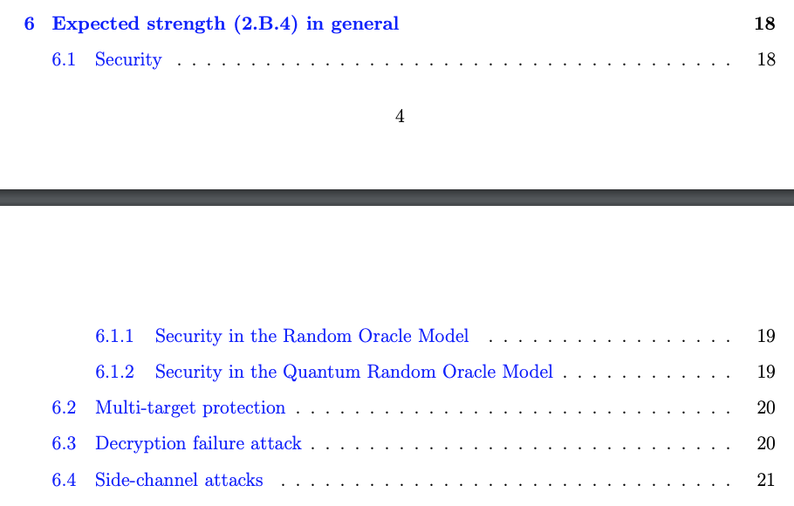
Security – Saber overall security analysis

Slide 10
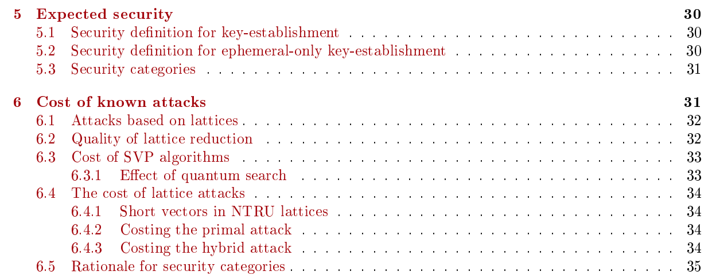
Security – NTRU overall security analysis

Slide 11
Security recap
Do any of Kyber, Saber, or NTRU have security advantages over the others?
Discussion

Slide 12
Performance – parameter sizes
 | Kyber | Saber | NTRU
 |  |  | NTRUhps2048509 PK: 699 SK: 935 CT: 699
Category 1 | Kyber512 PK: 800 SK: 1632 CT: 768 | Lightsaber PK: 672 SK: 1568 CT: 736 | NTRUhrss701 PK: 1138 SK: 1452 CT: 1138 NTRUhps204877 PK: 931 SK: 1235 CT: 931
Category 3 | Kyber768 PK: 1184 SK: 2400 CT: 1088 | Saber PK: 992 SK: 2304 CT: 1088 | NTRUhps4096821 PK: 1230 SK: 1592 CT: 1230
Category 5 | Kyber1024 PK: 1568 SK: 3168 CT: 1568 | Firesaber PK: 1312 SK: 3040 CT: 1472 | NTRUhps40961229 PK: 1842 SK:~2395 CT: 1842 NTRUhrss1373 PK: 2401 SK:~3063 CT: 2401
Saber is the smallest
Kyber is about 10% bigger than Saber
NTRUhps is about 25% bigger than Saber. NTRUhrss is about 65% bigger than Saber

Slide 13
Performance – bandwidth graph
Category 1 Category 3 Category 5

Slide 14
Performance – cycle counts (Haswell)
 | Kyber | Saber | NTRU
Category 1 | Kyber512 KeyGen: 33,856 Encaps: 45,200 Decaps: 34,572 | Lightsaber KeyGen: 45,232 Encaps: 62,236 Decaps: 62,624 | NTRUhrss701 KeyGen: 340,823 Encaps: 50,441 Decaps: 62,267 | NTRUhps204877 KeyGen: 309,216 Encaps: 83,519 Decaps: 59,729
Category 3 | Kyber768 KeyGen: 52,732 Encaps: 67,624 Decaps: 53,156 | Saber KeyGen: 80,340 Encaps: 103,204 Decaps: 103,092 |  | NTRUhps4096821 KeyGen: 431,667 Encaps: 98,809 Decaps: 75,384
Category 5 | Kyber1024 KeyGen: 73,544 Encaps: 97,324 Decaps: 79,128 | Firesaber KeyGen: 126,220 Encaps: 153,832 Decaps: 155,700 | NTRUhrss1373 | NTRUhps40961229
Kyber is the most efficient (on Haswell), across the board
NTRU has a noticeably slower KeyGen
Notes:
#’s from spec and Supercop are comparable to within 1-2%
These are from spec
Dropping the <cat 1 ntru parameter set

Slide 16
Saber is about 5% smaller than Kyber in this metric
NTRU is 30-70% bigger than Saber

Slide 17
Saber is about 6-9% smaller than Kyber in this metric
NTRU is 25-70% bigger than Saber

Slide 18
Performance – cycle counts (Cortex-M4)
 | Kyber | Saber | NTRU
Category 1 | Kyber512 KeyGen: 457,126 Encaps: 551,681 Decaps: 511,970 | Lightsaber KeyGen: 352,196 Encaps: 481,006 Decaps: 452,654 | NTRUhrss701 KeyGen: 149,737,679 Encaps: 375,948 Decaps: 867,921 | NTRUhps204877 KeyGen: 143,750,608 Encaps: 820,054 Decaps: 812,608
Category 3 | Kyber768 KeyGen: 744,136 Encaps: 898,630 Decaps: 838,939 | Saber KeyGen: 645,222 Encaps: 820,799 Decaps: 774,055 |  | NTRUhps4096821 KeyGen: 208,835,960 Encaps: 1,027,338 Decaps: 1,031,141
Category 5 | Kyber1024 KeyGen: 1,190,374 Encaps: 1,373,614 Decaps: 1,295,290 | Firesaber KeyGen: 994,446 Encaps: 1,204,260 Decaps: 1,151,016 | NTRUhrss1373 | NTRUhps40961229
Saberr is the most efficient (on cortex-M4), across the board
NTRU has a way slower KeyGen, but NTRUhrss has very fast Encaps
Notes:
#’s from spec and Supercop are comparable to within 1-2%
These are from spec
Dropping the <cat 1 ntru parameter set

Slide 21
Saber is about 10-15% smaller in this metric

Slide 22
Performance – memory usage (pqm4)
Kyber is a little smaller than Saber, with the gap narrowing as the security categories get higher

Slide 23
Performance – implementation issues
Decryption failures:
Kyber: 2⁻¹³⁹, 2⁻¹⁶⁴, and 2⁻¹⁷⁴
Saber: 2⁻¹²⁰, 2⁻¹³⁶, 2⁻¹⁶⁵
NTRU: no decryption failures
Kyber
All parameter sets use $n=256, q=329$. Just dimension $k(=2,3,4)$ changes
Fast NTT arithmetic
They have a 90’s version which uses AES and SHA-256 to show the effect of hardware acceleration (about 30-35% faster)

Slide 24
Performance – implementation issues (cont)
Saber
All parameter sets use $n=256, q=213$. Just dimension $l\left(=2,3,4\right)$ changes
No NTT arithmetic, but no modular reduction and no rejection sampling
They added a 90s version, and a ‘uniform sampling’. They 90s version is about ~30% faster, while the uniform sampling variant is about 10% faster (but has more limited parameter flexibility)
NTRU
Has both hps and hrss versions (they recommend hrss)
If the same noise is used to encrypt for different public keys, there’s a dramatic security loss. The NTRU spec does nothing to explicitly prevent this particular misuse (other than expecting values specified as random not to repeat.) Could be fixed by hashing random number with public key in encaps.

Slide 25
Performance – real world experiments
Kyber: Cloudflare, Amazon, IBM, KEMTLS
Saber: ?
NTRU: CEPQ2, Cloudflare/Google, KEMTLS
Recent KEMTLS-PDK includes all 3 finalists

Slide 26
Performance recap
Do any of Kyber, Saber, or NTRU have performance advantages over the others?
Saber’s key/ciphertext sizes are smaller
Kyber is faster on Haswell, Saber faster on Cortex-M4
NTRU KeyGen is noticeably slower
Discussion

Slide 27
Performance recap
Do any of Kyber, Saber, or NTRU have performance advantages over the others?
Discussion

Slide 28
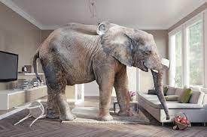
Algorithm char. – IP considerations
Kyber and Saber both have patent threats from CNRS
And possibly Ding
NTRU’s original patents expired in 2017
The owners put them in the public domain in 2017

Slide 29
Algorithm char. – simplicity, flexibility, clarity of specification
Flexibility
NTRU: Easy to scale parameters for size vs security trade-offs. They have charts showing hundreds of options . They give several variants in their spec (faster keygen, etc)
All three specifications appear detailed and easy to understand

Slide 30
Algorithm char. – advantages and disadvantages
Kyber
Advantages
Efficient, small parameters
Based on MLWE
Ease of implementation
Scalability
Faster KeyGen than NTRU
No “NTRU structure”
No “LWR structure”
Disadvantages
Not as fast as NTRU Encaps for some benchmarks

Slide 31
Algorithm char. – advantages and disadvantages
Saber
Advantages
No modular reduction
One ring for all parameter sets
Less pseudorandomness needed
Uniform sampling
Lower bandwidth than other finalists
No NTT means only need generic multiplication
No full multiplications (one element is always small)
Natural constant time
Very efficient masking techniques
Disadvantages
Can’t use NTT
Only a KEM, no related signature scheme

Slide 32
Algorithm char. – advantages and disadvantages
NTRU
Advantages
No decryption failures
Well-studied, i.e. old
Flexible (easy to scale to any security level)
Simple, with only 2 parameters
Fast, especially NTRUhrss701
Compact in size
Patent free
Skipping CCA doesn’t lead to much better performance
Disadvantages
Probably not the overall fastest, securest, or smallest
Optimal parameters not known due to current understanding of lattice attacks
Exists some structure that could be exploited

Slide 33
Algorithm char. – side channel analysis
Kyber’s spec points to 2 talks in our 3rd round workshop (Heinz and van Beirendonck). Also points to eprint 2021/483
Saber spec links to several relevant papers. They claim less randomness means its easier to mask
Borne out by early results?
NTRU’s spec doesn’t mean side channels in any way

Slide 34
Algorithm char. – pqc-forum discussion/comments
NTRU has 4 pages of official comments
Updated security analysis for LWE w/ side information. DJB disputes some of NTRU report write-up. NTRU announces category 5 parameters. More security discussion
Saber has 4 pages of official comments
Bug in LWE estimator, corrected in round 3 tweaks. Some discussion on side-channel attacks
A lot of the comments for Kyber are relevant to Saber

Slide 35
Algorithm char. – pqc-forum discussion/comments
Kyber has 97 pages of official comments! (thru Jan 2021)
Over half are comments by one researcher
Lots of discussion on coresvp security. Kyber updated their security analysis.
Lots of patent discussion

Slide 36
Algorithm characteristics recap
Do any of Kyber, Saber, or NTRU have specific algorithmic advantages over the others?
Besides the obvious patent issue?
Discussion

Slide 37
Overall recap
Considering our criteria,
Which of Kyber, Saber, and NTRU do we prefer?
If IP were not an issue, which one would we prefer?

